Slide 1
Structure of DNA M.Sc.3rdSemester

Slide 2
ushamasih12@gmail.com Dr.Usha Masih Associate Professor Botany

Slide 3
J.D.Watson and F.H.C. Crick (1953) combined the physical and chemical data, and proposed a double helix model for DNA molecule. This model is widely accepted. According to this model, the DNA molecule consists of two strands which are connected together by hydrogen bonds and helically twisted.

Slide 4
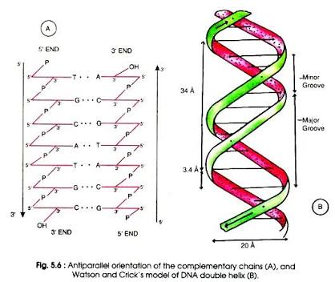

Slide 5
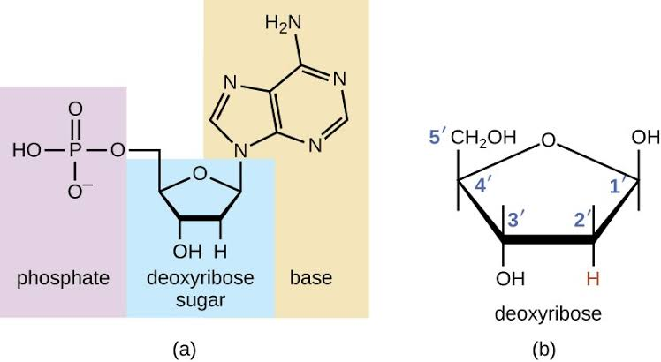

Slide 6
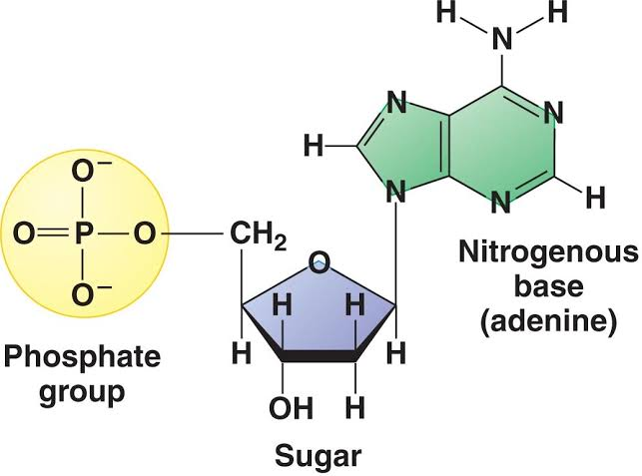

Slide 7
DNA polymerases - synthesize new DNA molecules by adding nucleotides to leading and lagging DNA strands. Topoisomerase or DNA Gyrase - unwinds and rewinds DNA strands to prevent the DNA from becoming tangled or supercoiled. Exonucleases - group of enzymes that remove nucleotide bases from the end of a DNA chain. DNA ligase - joins DNA fragments together by forming phosphodiester bonds between nucleotides.

Slide 8
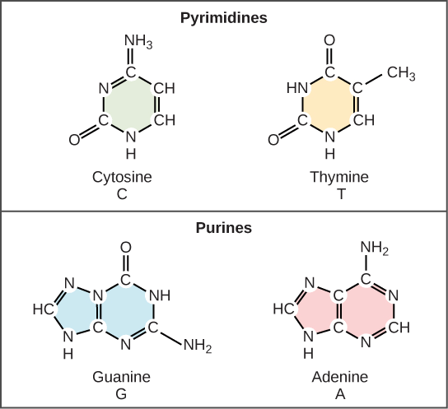

Slide 9
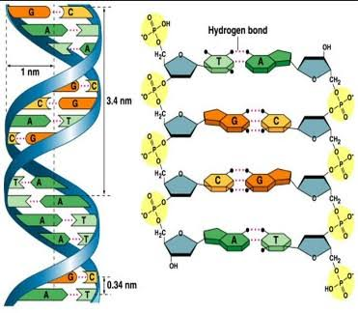

Slide 10
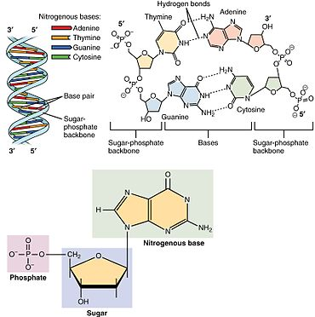

Slide 11
This nucleotide contains the five-carbon sugar deoxyribose (at center), a nitrogenous base called adenine (upper right), and one phosphate group (left). The deoxyribose sugar joined only to the nitrogenous base forms a Deoxyribonucleoside called deoxyadenosine, whereas the whole structure along with the phosphate group is a nucleotide, a constituent of DNA with the name deoxyadenosine monophosphate.

Slide 12
DNA) is a molecule composed of two chains that coil around each other to form a double helix carrying genetic instructions for the development, functioning, growth and reproduction of all known organisms and many viruses. DNA and ribonucleic acid (RNA) are nucleic acids; alongside proteins, lipids and complex carbohydrates (polysaccharides), nucleic acids are one of the four major types of macromolecules that are essential for all known forms of life.

Slide 13
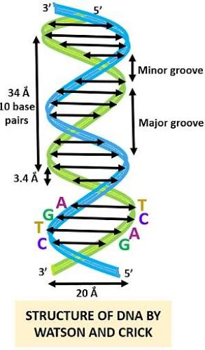

Slide 14
The two DNA strands are also known as polynucleotides as they are composed of simpler monomeric units called nucleotides. Each nucleotide is composed of one of four nitrogen-containing nucleobases (cytosine [C], guanine [G], adenine [A] or thymine [T]), a sugar called deoxyribose, and a phosphate group. The nucleotides are joined to one another in a chain by covalent bonds between the sugar of one nucleotide and the phosphate of the next, resulting in an alternating sugar-phosphate backbone.

Slide 15
The nitrogenous bases of the two separate polynucleotide strands are bound together, according to base pairing rules (A with T and C with G), with hydrogen bonds to make double-stranded DNA. The complementary nitrogenous bases are divided into two groups, pyrimidines and purines. In DNA, the pyrimidines are thymine and cytosine; the purines are adenine and guanine.

Slide 16
A large part of DNA (more than 98% for humans) is non-coding, meaning that these sections do not serve as patterns for protein sequences. The two strands of DNA run in opposite directions to each other and are thus antiparallel. Attached to each sugar is one of four types of nucleobases (informally, bases). It is the sequence of these four nucleobases along the backbone that encodes genetic information. RNA strands are created using DNA strands as a template in a process called transcription, where DNA bases are exchanged for their corresponding bases except in the case of thymine (T), for which RNA substitutes uracil (U)

Slide 17
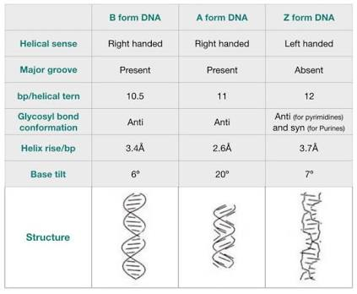

Slide 18
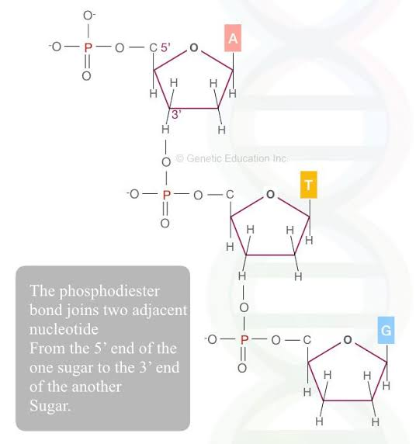

Slide 19
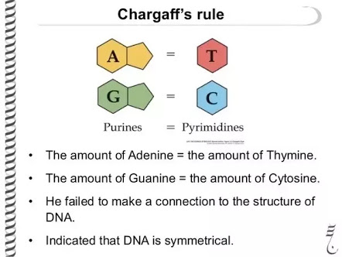

Slide 21
the number of purines (A+G) always approximates the number of pyrimidines (T+C), an obvious consequence of the base-pairing nature of the DNA double helix.
Summary Chargaff's rule 1 is that the number of guanine units approximately equals the number of cytosine units and the number of adenine units approximately equals the number of thymine units. Chargaff's rule 2 is that the composition of DNA varied from one species to another. The base paring rules state that A always pairs with T and G always pairs with C.

Slide 22
